Slide 1
CAC
To the Moon
Experiment conducted by:
Students: Calida Mills, Gehrig Dixon, Kevin Segovia, Arturo Luse, Gerard Dsouza
Mentors: Professor Armineh Noravian, Professor John Morris Jr.
Gasses present at various altitudes

Slide 2


Project Approach
Conducted research
Designated task
Formulated a plan to construct the device
Determined desired outcome -Devised test plan
Constructed the device
Tested subsystems and simulations
Launched the Device
Analyzed the results

Slide 3
Problem Statement
The hypothesis is that there will be a higher concentration of the lighter gases compared to the heavier ones at higher altitudes, as heavier gases tend to sink compared to lighter ones.

Slide 4
Design Statement
This payload is designed to collect data on the concentration of greenhouse gases, such as carbon dioxide, carbon monoxide, nitrous oxide, methane, and water vapor, in parts per million (ppm) at various altitudes using gas and altitude sensors.

Slide 5
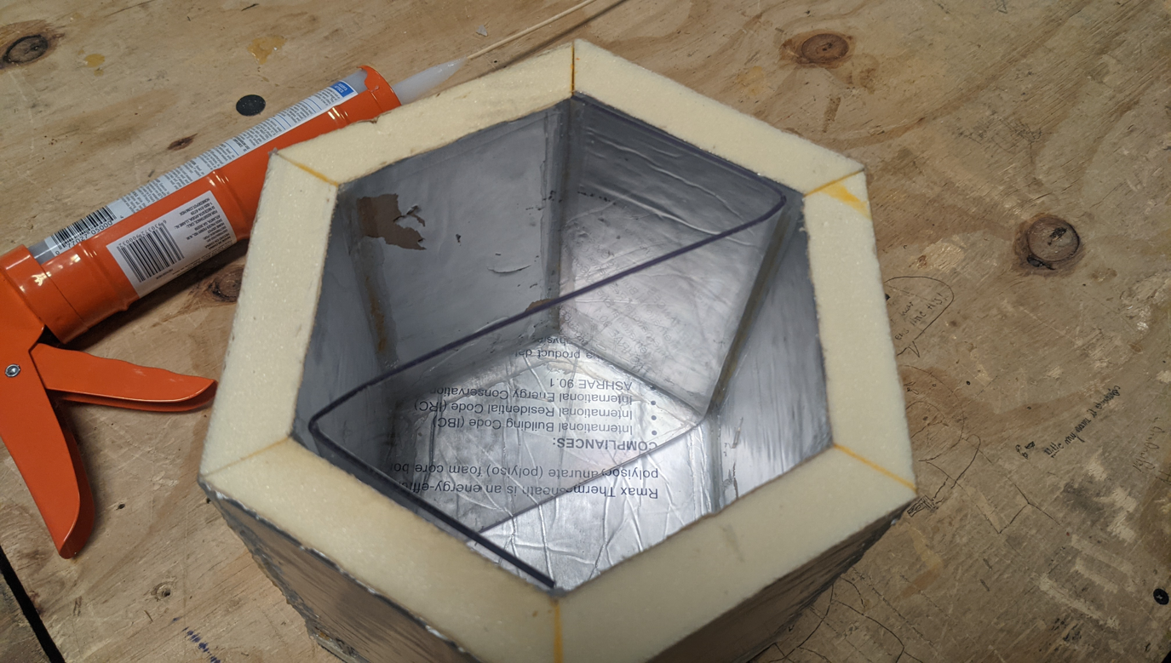
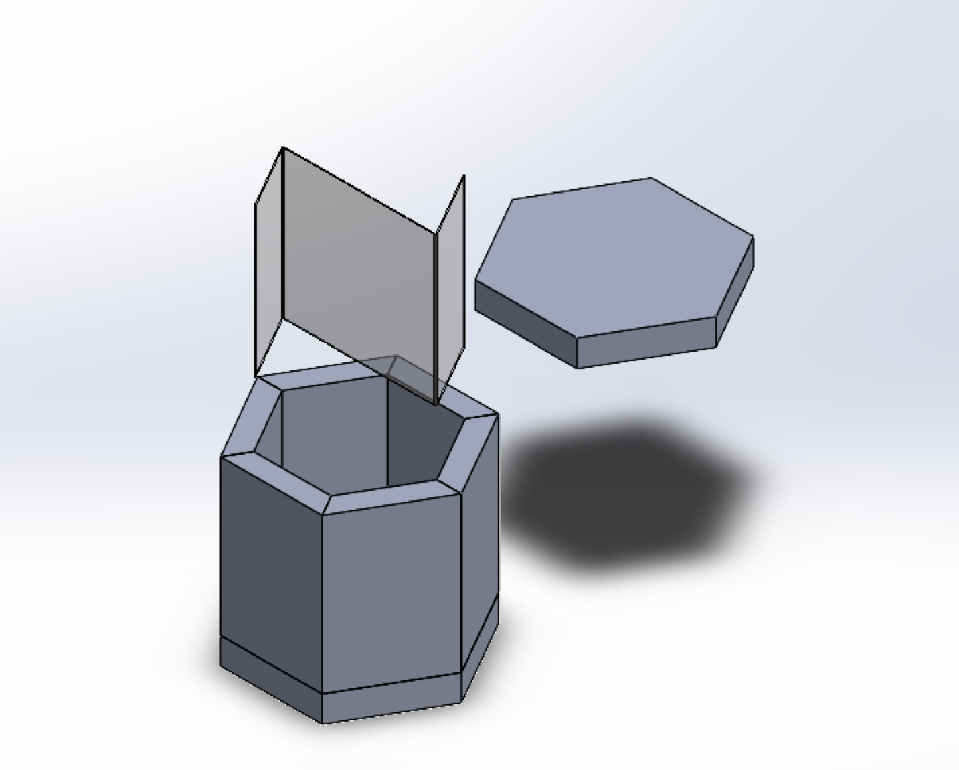
Payload Construction
•Made from 1"-thick foam insulation board
•Glued together with wood glue; sealed with silicone (minus the lid) and duct tape
•Polycarbonate sheet bent to form a "Z" shape for electronics mounting

Slide 6
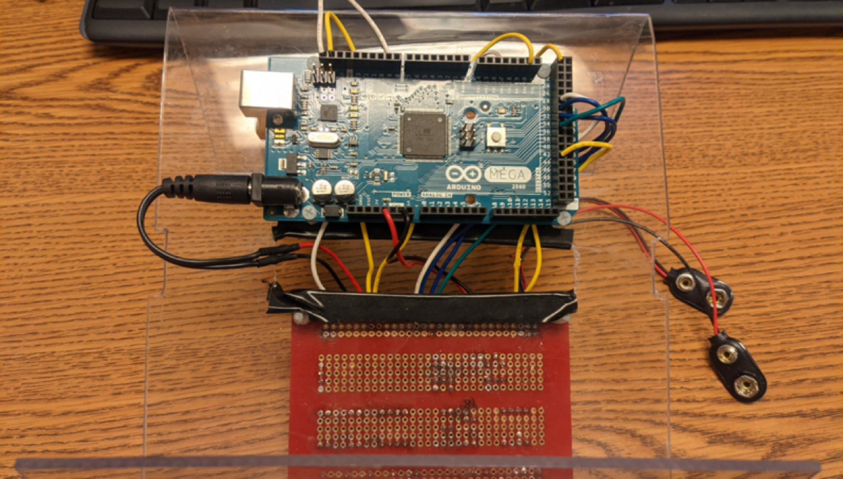
Controller and Power Distribution
Utilized a solderable breadboard as a “hub” board to interface between sensors
Both boards are mounted on the “Z” with nylon M3 screws
Wires were routed through a channel in the middle of the “Z”
Arduino MEGA 2560 Microcontroller

Slide 7
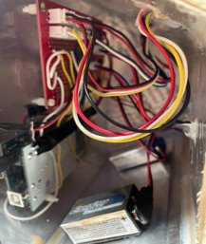
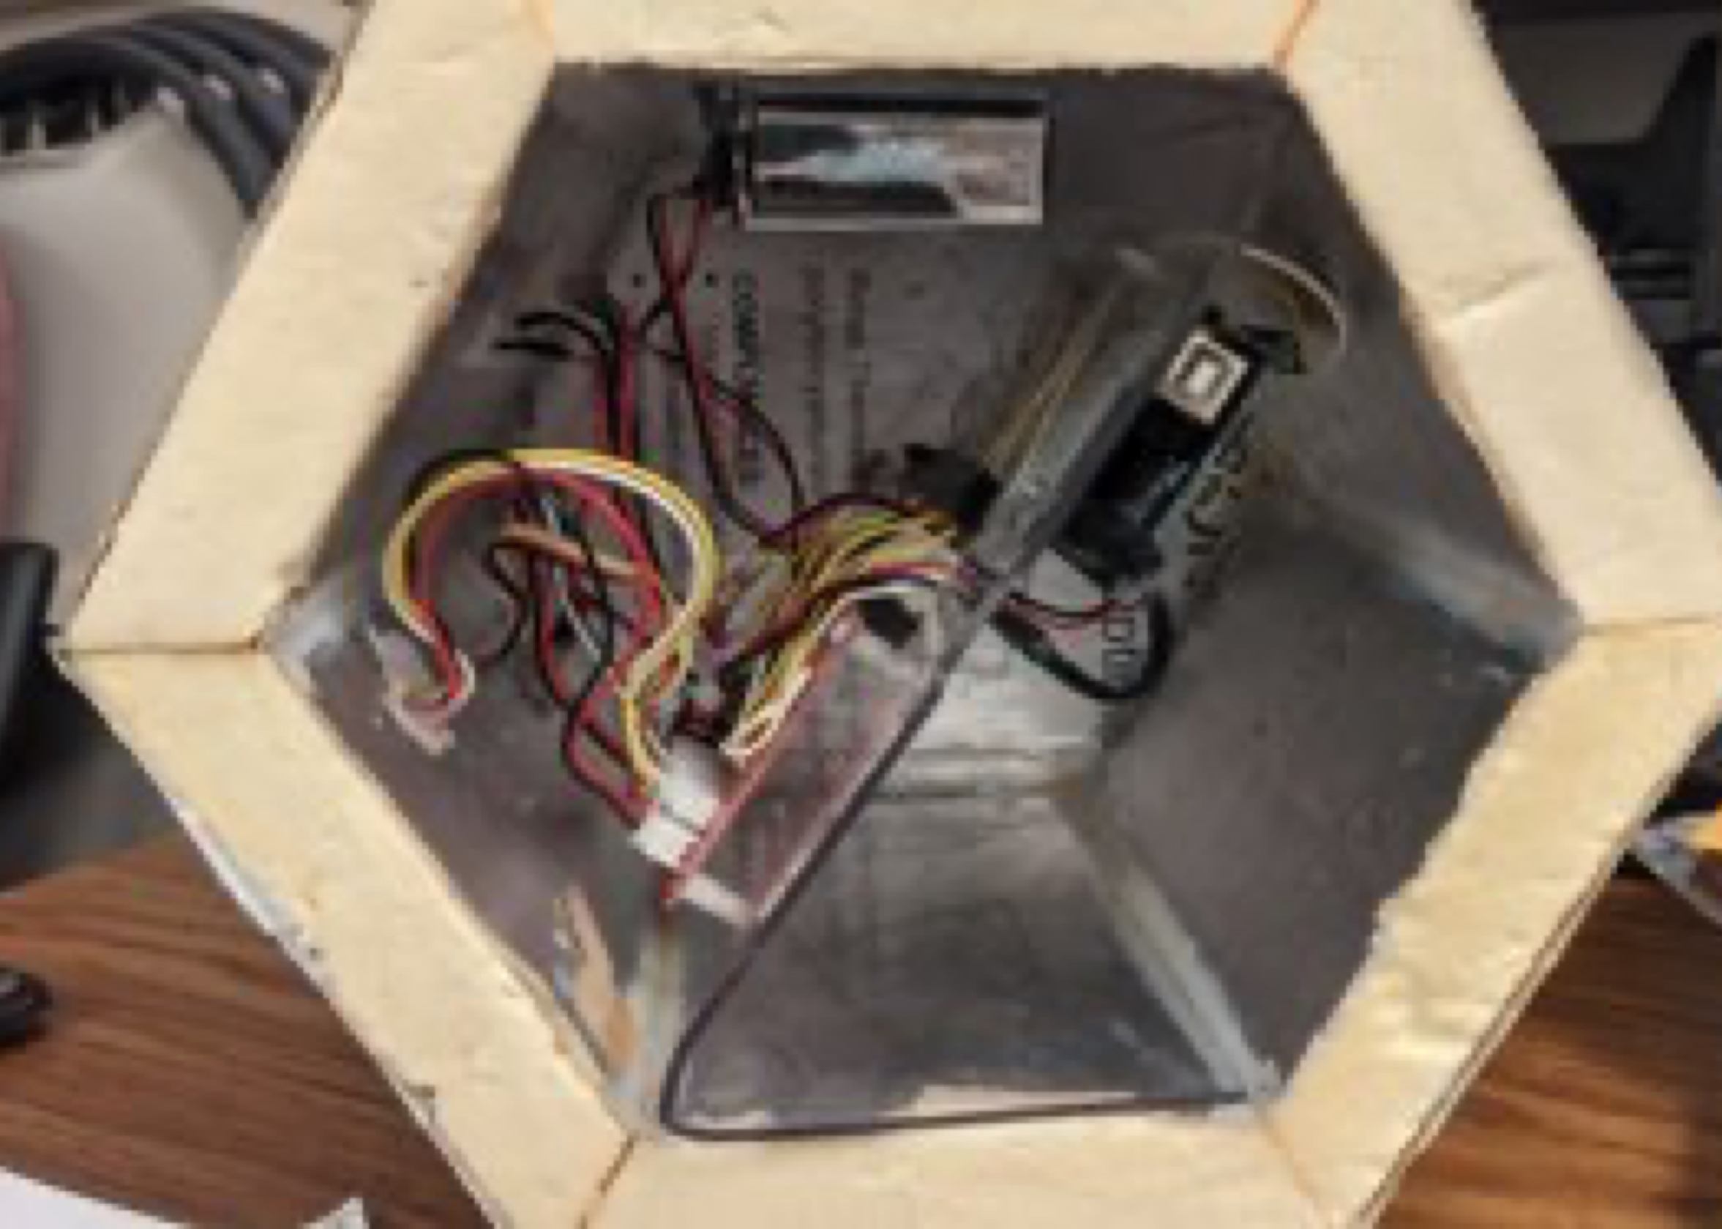
Internal Configuration
All peripherals are connected via JST connectors to allow for easy removal
External electronics were firmly embedded in the outer walls, and sealed internally with silicone

Slide 8
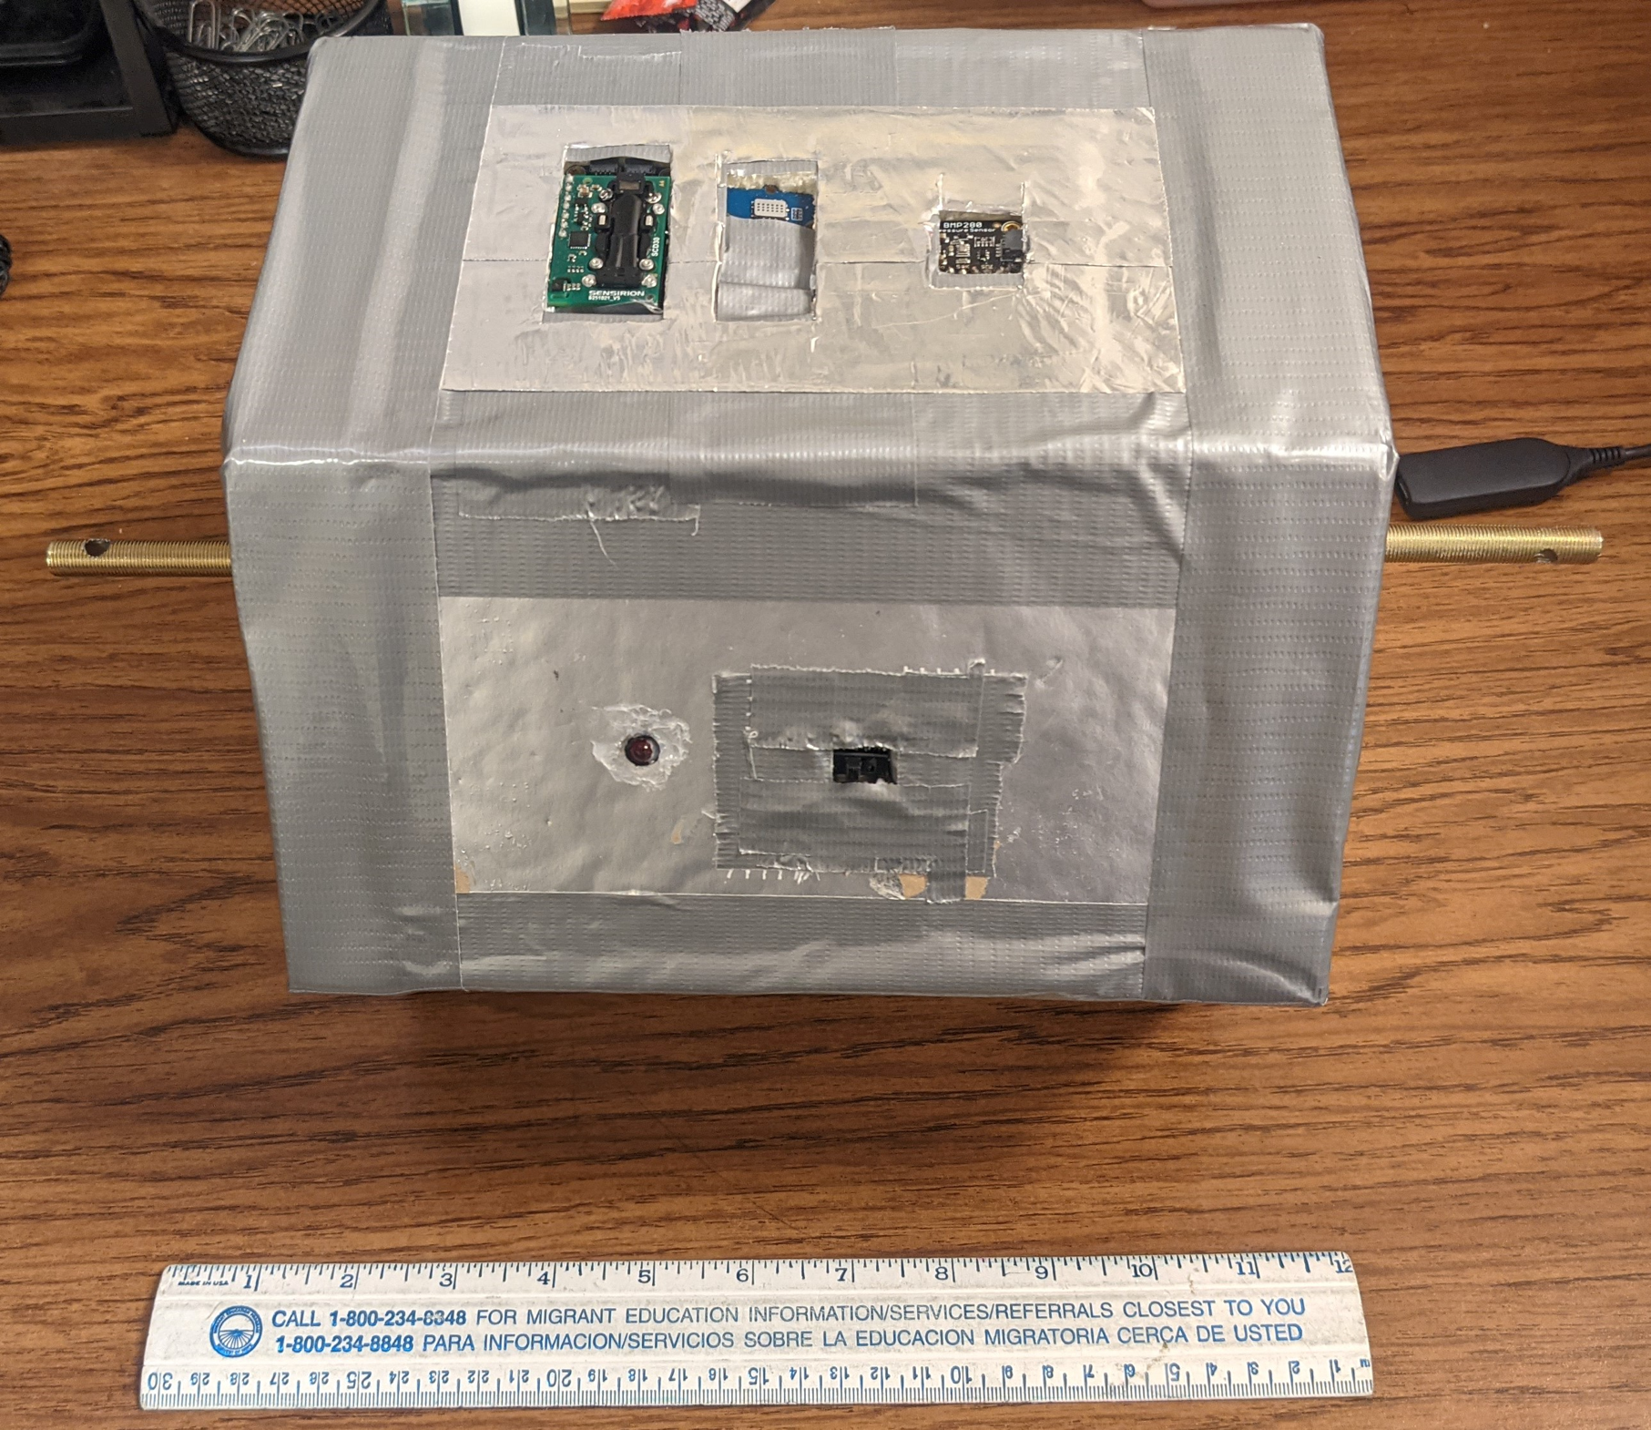
Sensors used in the payload
Carbon Dioxide Sensor SCD30
Temperature Sensor - DHT22
Grove Multi-Gas Sensor- Carbon Dioxide, Carbon Monoxide, Nitrous Oxide, Methane, Water Vapor
Altitude Sensor -BMP280

Slide 9
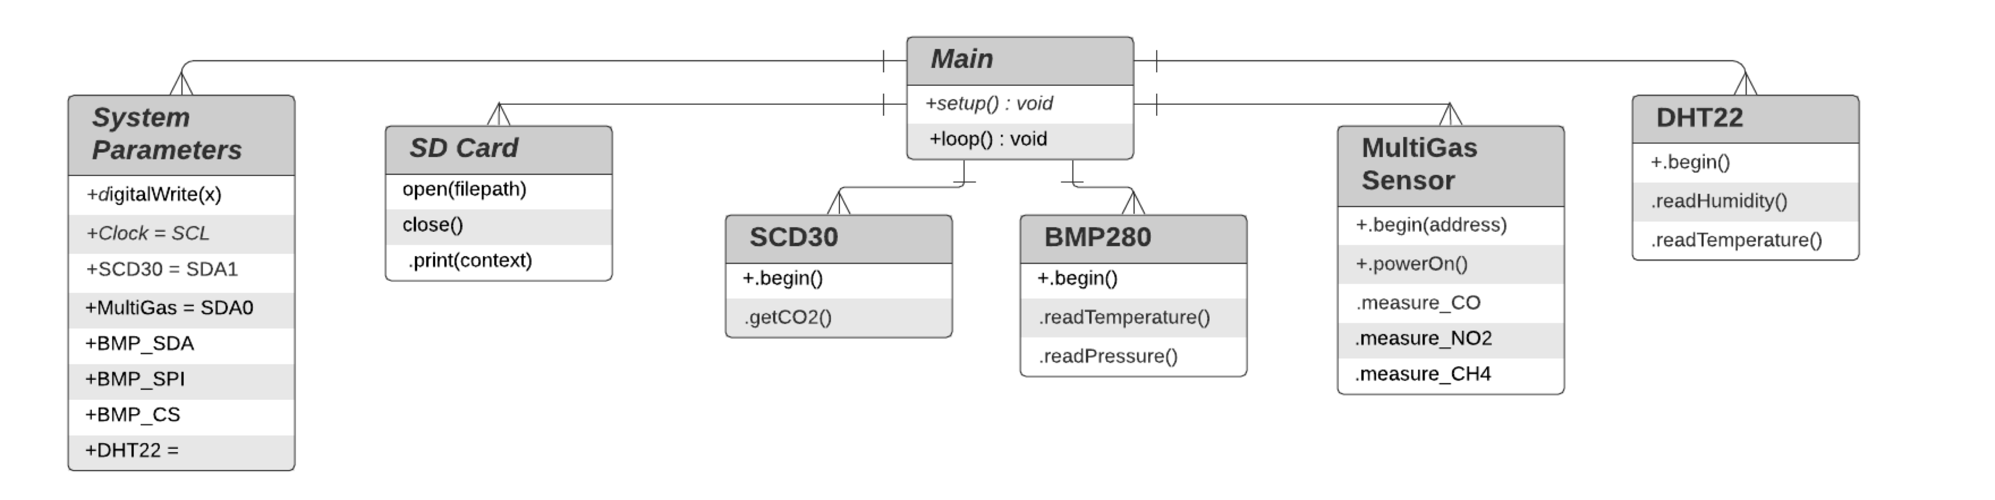
Software

Slide 10
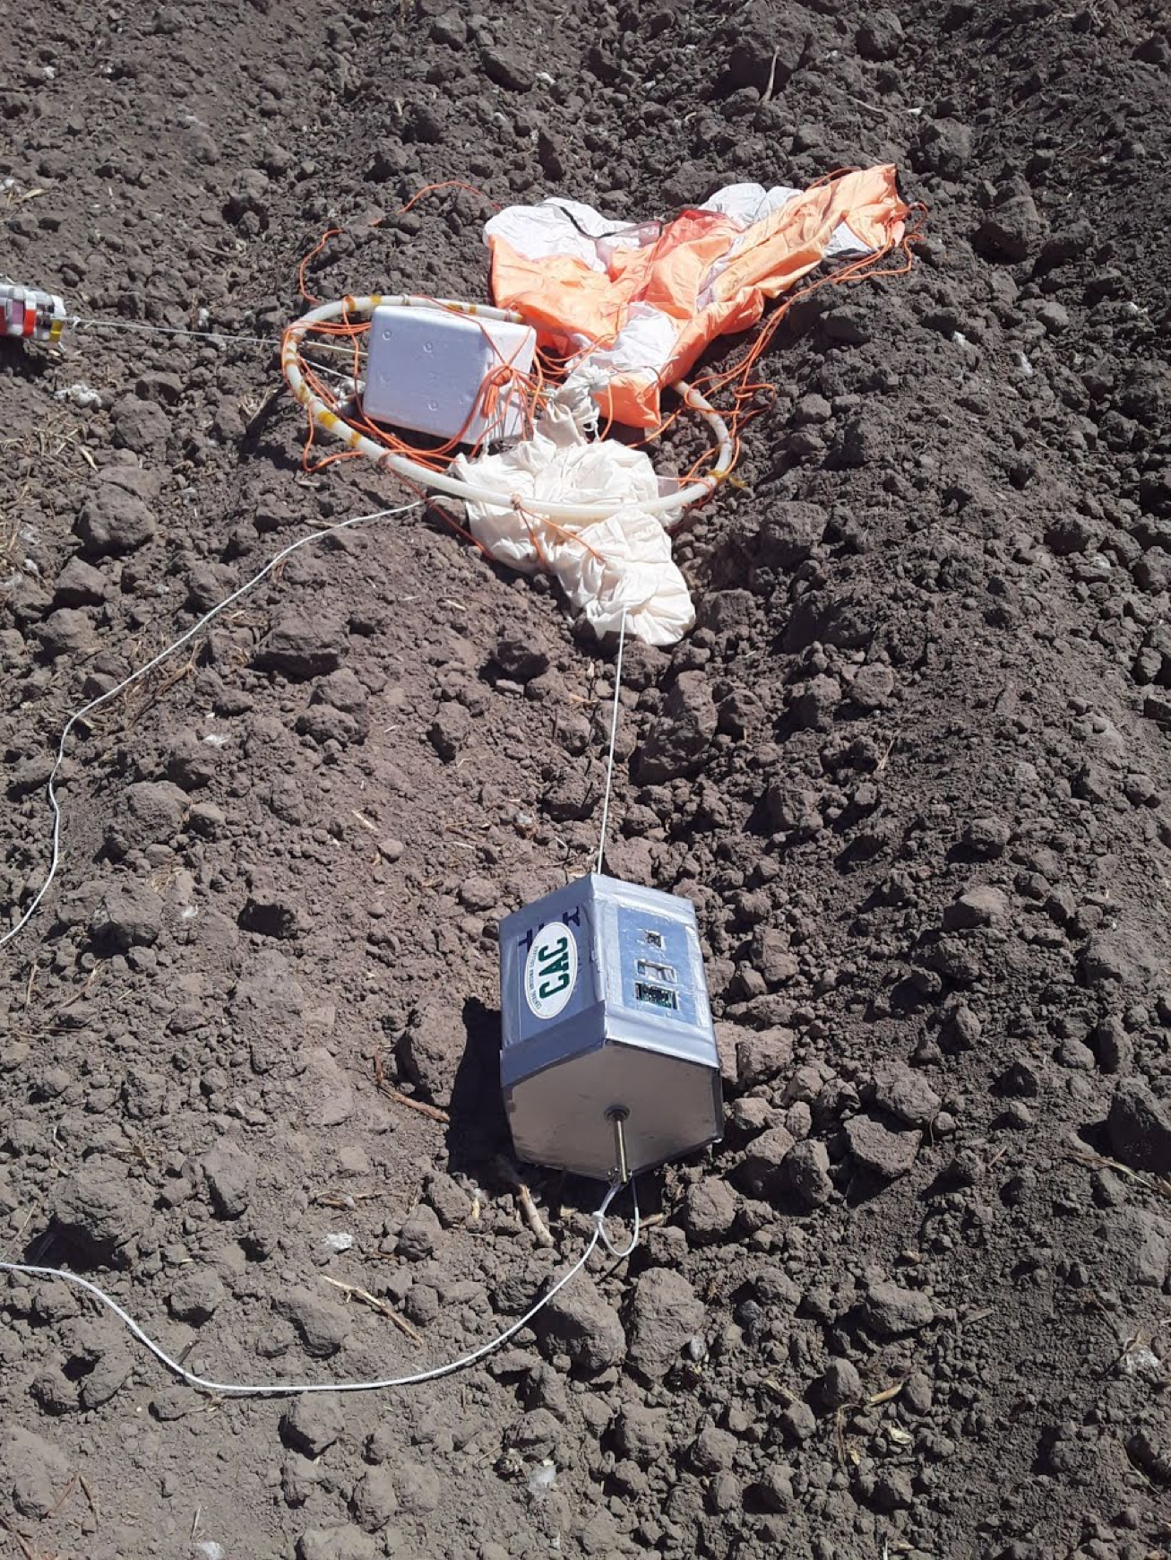
Post-Flight Results
Upon retrieval and inspection, we found that…
There was a crack in the bottom of our payload
The batteries’ voltages were much lower than we anticipated and were unleveled (roughly 2 and 4 volts respectively)
There were marks on the battery casings that indicated expansion and/or leakage of gas
The board used for writing data to the SD card was nonfictional
The heating element was incorrectly wired

Slide 11
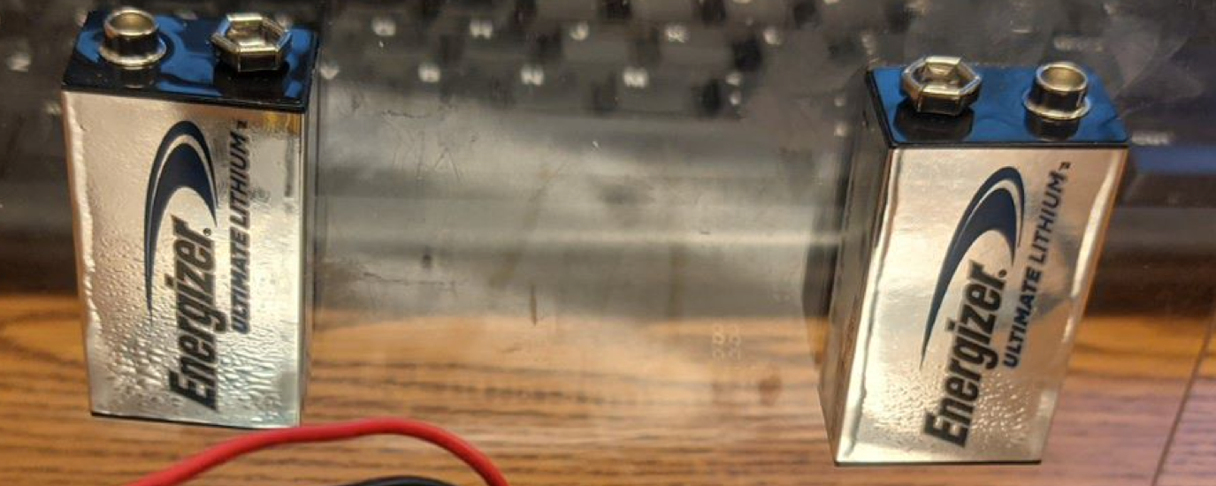
Process Improvements
More documentation
Electronics schematics
Software Flowcharts
Detailed CAD models of internal payload
More quality checks and more testing

Slide 12
Thank you
Q & A
Arizona Space Grant Consortium Hosted Via Zoom
April 17th 2021

